Slide 1
Introduction to Machine Learning
Introduction to Machine Learning
Notes:
Unit 1: Introduction to Machine Learning
Module 1: Introduction to Machine Learning

Slide 2


Objective
Objective
Objective
Define machine learning
Illustrate key elements of machine learning
Notes:
Unit 1
Module 1: Define Machine Learning and illustrate key elements of machine Learning

Slide 3
What is Machine Learning?
Many different definitions for “machine learning”
All involve learning by a machine (computer)
Definition of learning in a typical dictionary: “the acquisition of knowledge or skills through experience, study, or by being taught”
Can machines be enabled to learn, without being explicitly programed?
Learning and adaption
Notes:
Different definitions focus on different aspects: classification, prediction, modeling, pattern recognition, etc.
Learning enables adaption; Adaptivity of a system is the ultimate test whether a system can learn.

Slide 4
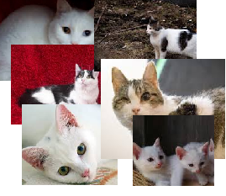
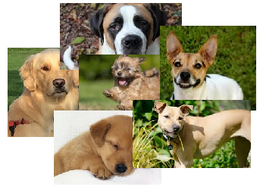
An Illustrative Example
Given some example pictures, how a computer can learn to differentiate dogs from cats?

Slide 5




Data Representation – Feature Extraction
Raw data: Images
Features

Slide 6
Different Types of Data Representation
Numerical; Categorical; Ordinal
Univariate or multivariate
➔ All could be represented by numbers.
Graphical representations in terms of nodes & edges
E.g., Social network analysis

Slide 7
Preprocessing for Feature Extraction
Segmentation
Filtering
Various transformations
➔ All intended for facilitating feature extraction
Good features should be invariant in some sense.

Slide 8
Mathematical Models for Classification
Notes:
In general, we will need a math model as a tool for achieving the task using the extracted features. In this illustrative example, the task is classification. Let’s see what type of models we may use for the task. Linear? Quadratic, etc.

Slide 9
Importance of Statistical Modeling
Why we often reply on statistical methods in machine learning?
Data is noisy (measurement noise) ➔ Features are often represented random variables/vectors.
Inaccuracy of the assumed model
Inherent ambiguity of many real-world problems

Slide 10
Basic Machine Learning Paradigms
Supervised learning:
the training samples have labels.
Unsupervised learning:
the training set is not labeled.
Reinforcement learning:
Learning to take actions to maximize some notion of reward.
Notes:
RL: learning to take actions in order to maximize some notion of reward.

Slide 12
Objective
Objective
Objective
Illustrate specific machine learning examples
Describe broad machine learning applications
Notes:
Unit 1 Introduction to Machine Learning
Module 2: Illustrate machine learning with more specific examples, and then describe broader applications of machine learning

Slide 13


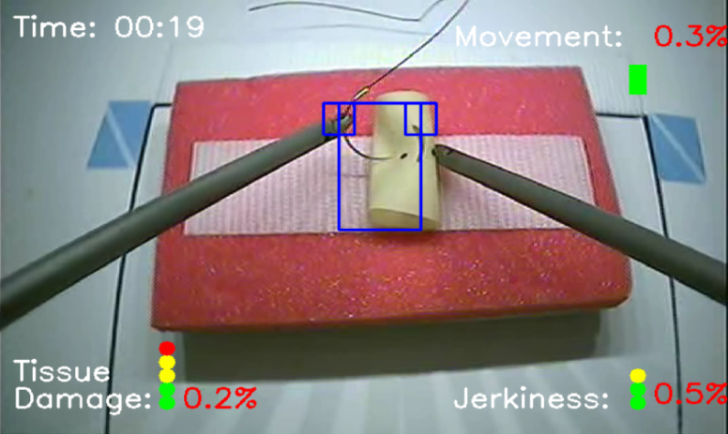
A Few Examples of Machine Learning (1/3)
Learning to assess skills in simulation-based laparoscopic surgery training
Learning to predict best answers in community Q & A
Notes:
Video data; “Latent” label.
Text data

Slide 14
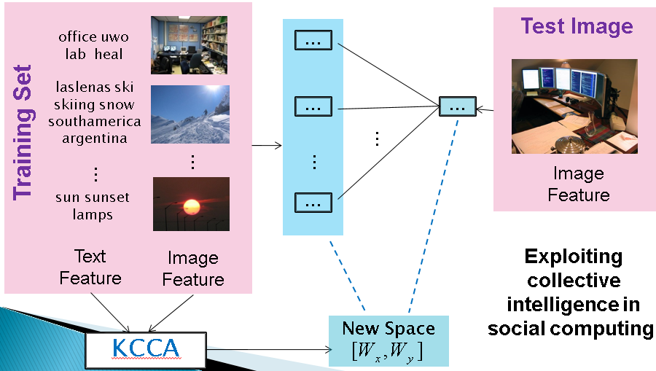
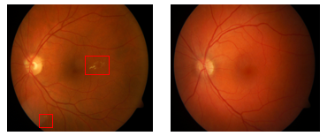
A Few Examples of Machine Learning (2/3)
Tag prediction/recommendation
Diabetic retinopathy detection
Notes:
Multi-modal data; cross-modality learning
Coarse label; multiple instance learning

Slide 15
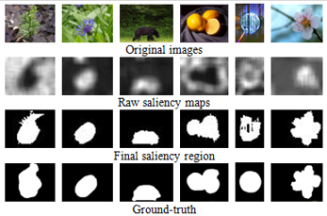



A Few Examples of Machine Learning (3/3)
Visual saliency detection
Computational visual aesthetics
Which one is more beautiful?
Notes:
Modeling a more “early-stage”/low-level vision task
Modeling artistic effect? Relative learning?

Slide 16
Broad Applications of Machine Learning
Computer vision
Speech recognition; natural language processing
Medical informatics
Robotics
Computational biology
Information technology
Finance

Slide 17
Information Technology
Spam detection
Web image search
Recommendation
Information filtering
Community detection
Adaptive advertisement
Sentiment analysis
Notes:
Spam detection: e.g., spam email
Web Image Search: e.g., search based on keywords, a description, or a sample image
Recommendation: e.g., shopping applications
Spam detection: e.g., spam email

Slide 18
Finance
Credit risk assessment
Fraud detection
Stock market prediction
Algorithmic trading
Return forecasting
Notes:
Credit risk assessment: use data to assess the risk levels associated with certain borrowers.
Fraud detection: e.g., how credit card companies proactively deactivate your compromised /lost credit cards (before you realize they are compromised/lost), based on fraudulent activities.
Algorithmic trading: a method of executing a large order (too large to fill all at once) using automated pre-programmed trading instructions accounting for variables such as time, price, and volume to send small slices of the order (child orders) out to the market over time.

